Slide 1
Introduction:
Diary Management System
Our project is a Personal Diary Management System developed in C programming language, designed to provide users with a secure and organized way to manage their personal notes and memories. The key functionalities include:
Add Entries
View Entries
Search Entries
Edit Entries
Delete Entries
Encryption
Authentication

Slide 2
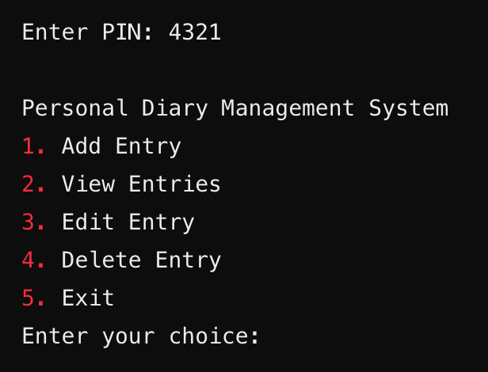
The main menu looks like this:

Slide 3
Add Entry + Encrypt
Planned feature to let users add a new diary entry with a specific date. The system will validate the date, encrypt the content using XOR encryption, and store it securely in a file.
Functionality Overview:
Prompts for Date Input → User enters a date in YYYY-MM-DD format.
Validates the Date → Ensures correctness, including leap year checks.
Checks for Duplicate Entry → Prevents multiple entries for the same date.
Prompts for Diary Content → User enters their diary note.
Encrypts the Entry → Uses XOR encryption before storing it.
Saves to File → Stores date and encrypted content in a structured file.
Displays Success Message → Confirms successful entry addition.
Returns to Main Menu → User is redirected back for further actions.

Slide 4
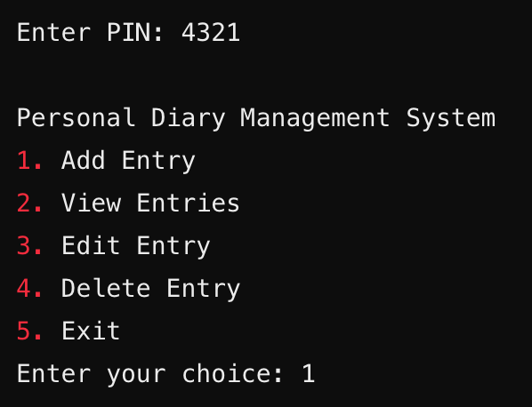
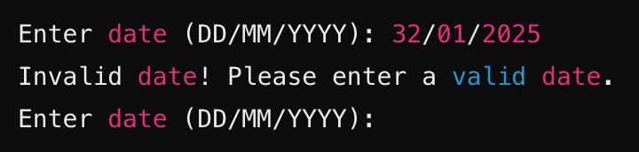
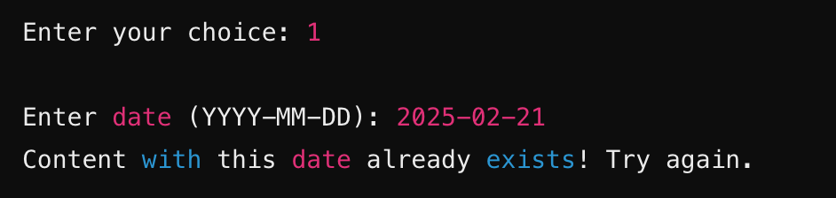
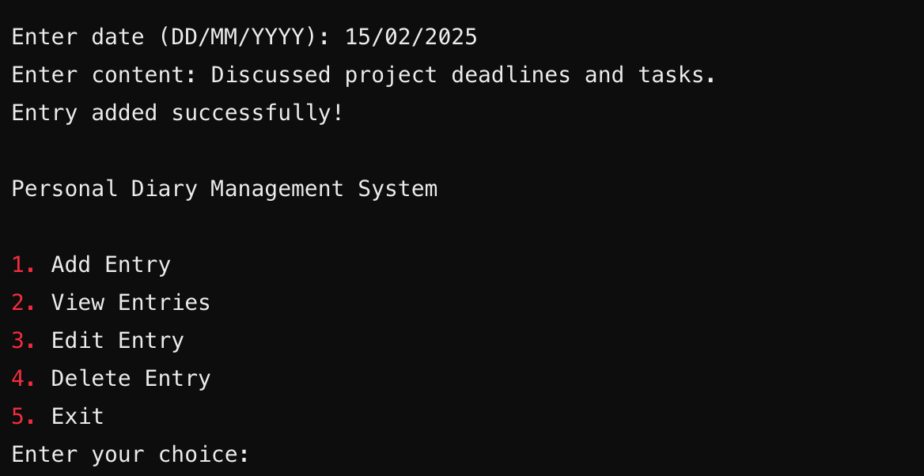
Expected Outcome:
3. the user will be prompted: "Enter date (YYYY-MM-DD):” and invalid dates will be rejected.
1. after successful authentication, the user will see the following options.
4. if content with a date already exists, the entry will be rejected.
2. the user chooses 1, the addEntry() function will be called.
5. after successfully entering the date, user will add the entry, and will see a confirmation message: "Entry added successfully!”
And the encrypt() function will be called before storing it.
6. the user will then be redirected to the main menu to choose the next action.

Slide 5
View Entry
Planned feature to let users view the existing entries in chronological order.
Functionality Overview:
Opens the File → Reads stored diary entries.
Decrypts Entries → Uses XOR decryption to restore original text.
Displays Entries → Lists all diary entries in chronological order.
Returns to Main Menu → After displaying, user is redirected back.

Slide 6
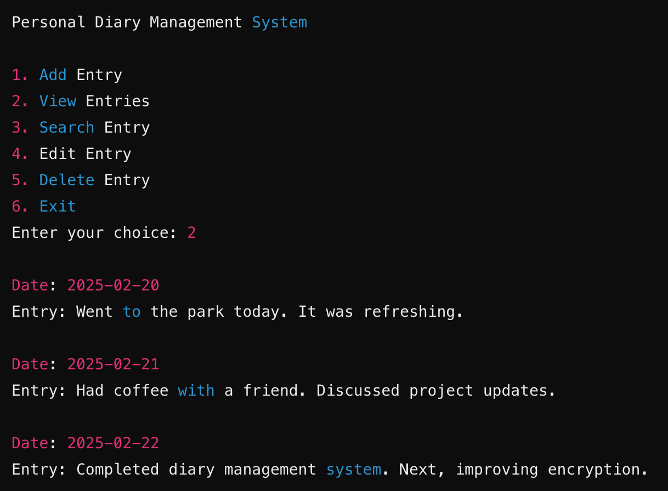
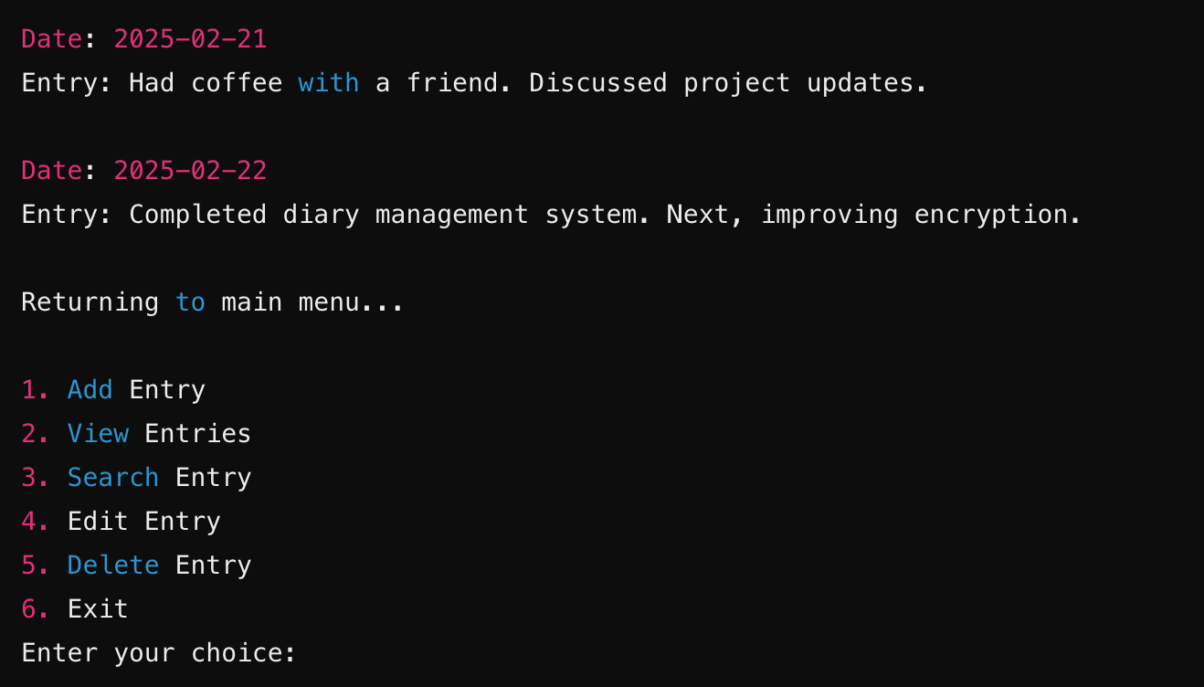
Expected Outcome:
1. the user chooses 2, the viewEntry() function will be called.
2. All diary entries will be displayed in chronological order.
And the user will then be redirected to the main menu to choose the next action.

Slide 7
Search Entry
Planned feature to let users search for a particular entry from the existing entries.
Functionality Overview:
Opens the File → Accesses the diary file in read mode to check all stored entries.
Gets Date from User → Prompts the user to enter a specific date (in YYYY-MM-DD format) to search for an entry.
Validates Date → Ensures the entered date is in the correct format and is a valid calendar date.
Reads Stored Entries → Loops through each saved diary entry in the file.
Compares Dates → Checks if the date of any entry matches the user-input date.
Decrypts Entry → If a matching date is found, uses XOR decryption to restore the original text.
Displays Matching Entry → Shows the date and decrypted content for the matching entry.
Shows Not Found Message → If no entry is found for the given date, displays: "No entry found for this date."
Returns to Main Menu → After checking all entries, the user is redirected back to the main menu.

Slide 8
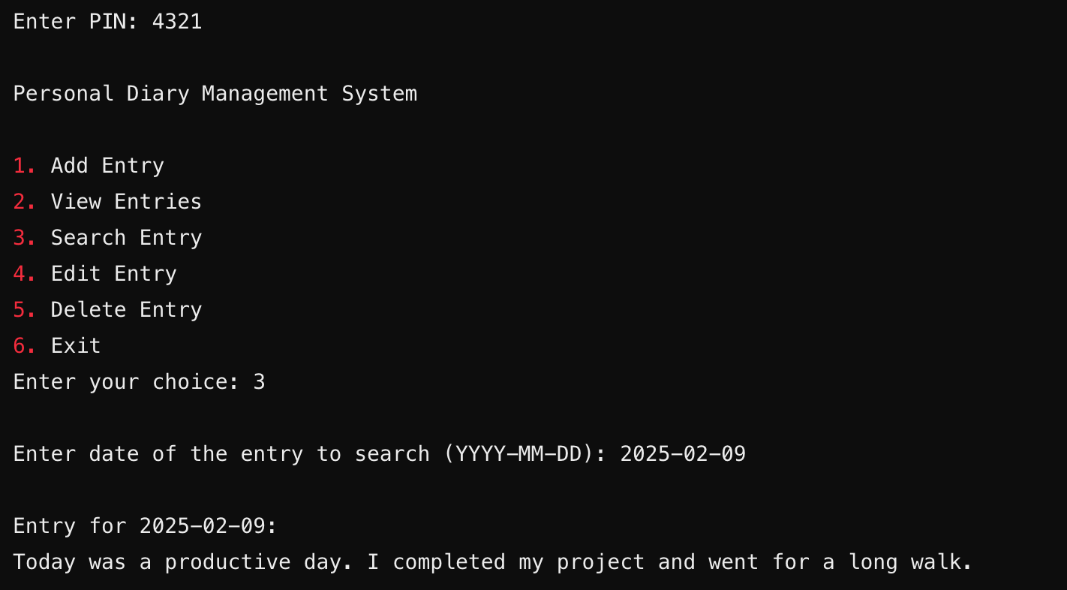
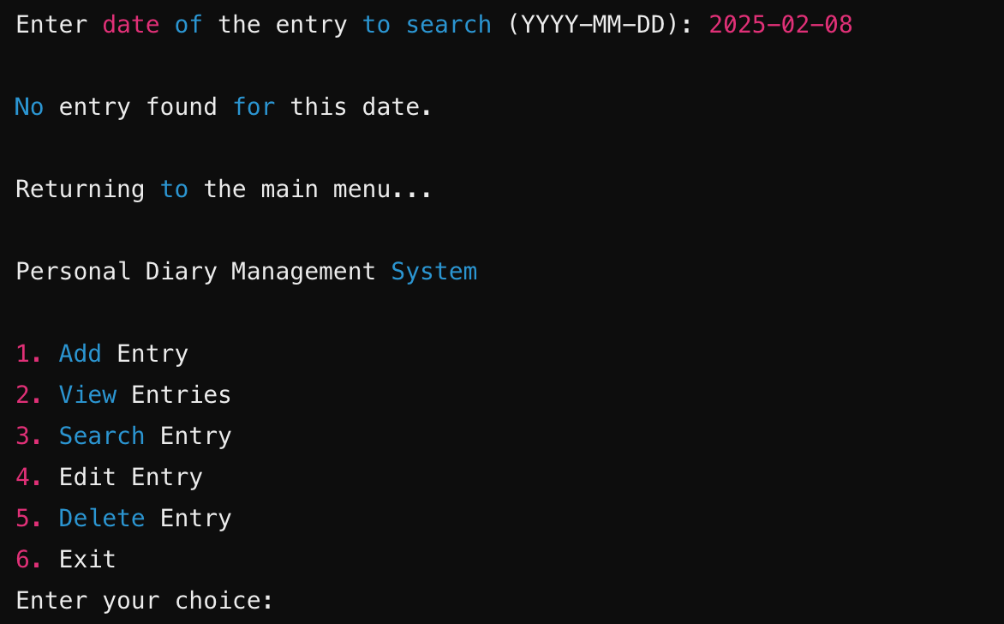
Expected Outcome:
1. After successful authentication, the user chooses 3, the searchEntry() function will be called.
2. After entering the date correctly, the user can see the entry.
3. If no entry exists from that date, error will be shown.
4. After completion, user will be redirected to main menu.

Slide 9
Edit Entry
Planned feature to let users add a new diary entry with a specific date. The system will validate the date, encrypt the content using XOR encryption, and store it securely in a file.
Functionality Overview:
Prompts for Date Input → User enters the date of the entry to edit.
Searches for Entry → After date validation, checks if the entry exists in the file.
Decrypts Existing Entry → Retrieves and shows current diary entry.
Prompts for New Content → User enters updated diary text.
Encrypts & Updates File → Replaces old content with new encrypted text.
Displays Success Message → Confirms successful editing.
Returns to Main Menu → User is redirected back.

Slide 10
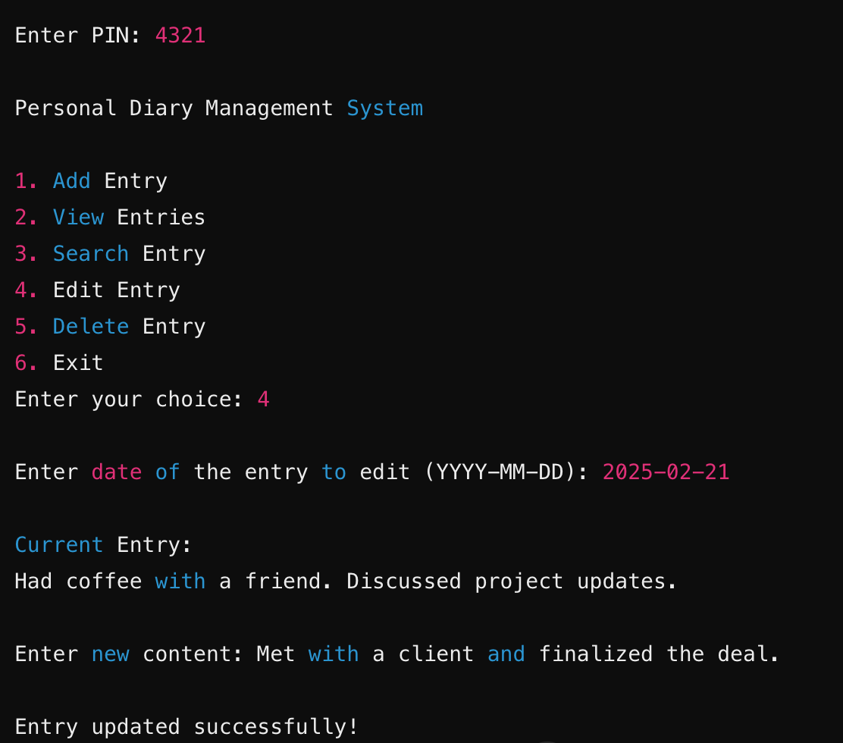
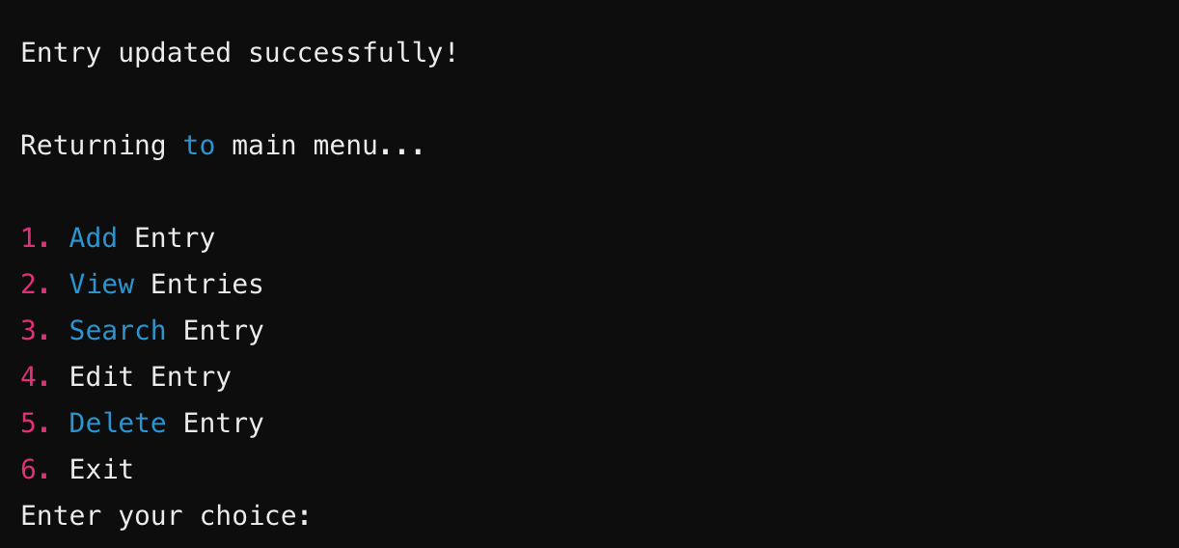
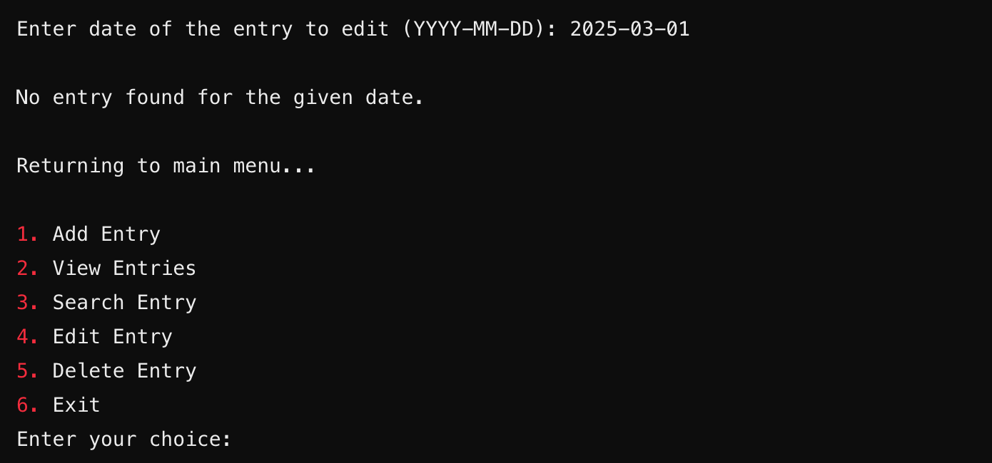
Expected Outcome:
1. When the user chooses 4, the editEntry() function will be called.
2. After searching by date, the current entry will be shown and user can update or modify the entry.
After completion, user will be redirected to main menu.
3. If entry does not exist with the entered date, an error message will be shown.

Slide 11
Delete Entry + Authentication
Planned feature to let users delete an existing diary entry by specifying a date. The system will remove the entry from storage permanently.
To ensure security and privacy, our application starts with PIN entry prompt. The system will prompt the user for a PIN at the start and grant access only if the correct PIN is entered.
Functionality Overview of Deletion:
Prompts for Date Input → User enters the date of the entry to delete.
Searches for Entry → Checks if the entry exists in the file.
Removes the Entry → Deletes the entry from storage.
Displays Success Message → Confirms successful deletion.
Returns to Main Menu → User is redirected back.

Slide 12


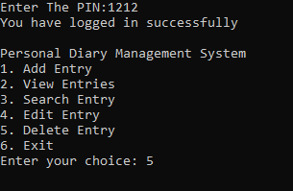

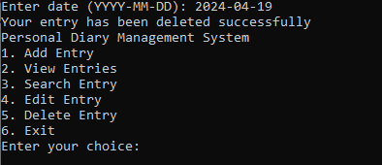
Expected Outcome:
1. The authenticate( ) function is called to get the correct pin from user
4. The user will be prompted :” Enter Date(YYYY-MM-DD)” and invalid dates will be rejected.
2. After successful authentication , the user will see the following options.
5. If there is no entry on a date deletion will be canceled.
3. if the user chooses 5,the deleteEntry() function will be called
6. After successfully entering the date , user will be notified that his entry has been deleted.
7. Then the user will redirected to the main menu to choose the next action

